Slide 1
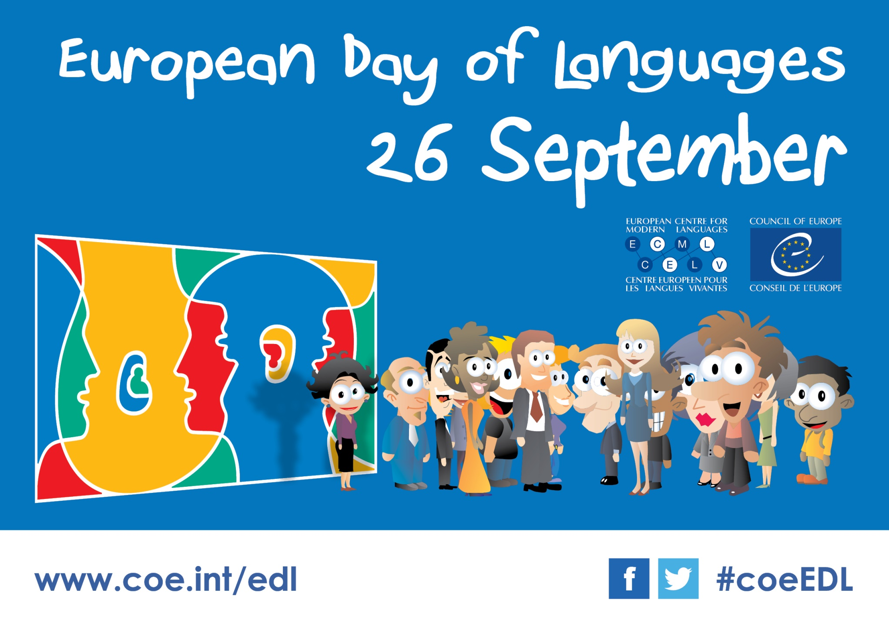
Notes:
Who speaks English? Who can speak another language? Who can speak 3 languages or more?

Slide 2
Can you think of the benefits of speaking other languages?
Notes:
Professional, leisure, fun, different reality/different me, good exercise for the brain

Slide 3
The benefits of a bilingual brain - Mia Nacamulli

Slide 4
Why an European Day of Languages
To raise awareness of the importance of language learning to help cultural understanding
To preserve and foster our rich linguistic and cultural diversity in Europe!
To encourage language learning in and out of school for professional needs or for pleasure.

Slide 5
How do we celebrate it at Pitsford School?
2 ACTIVITIES

Slide 6
Part 1: Language and Cultural Challenge
You will complete the challenges as a form group.
You have one week to complete it! (1st October)
For some challenges, you will have to provide evidence.
Winners will get points for their house!

Slide 7
Some challenges will involve…

Slide 8
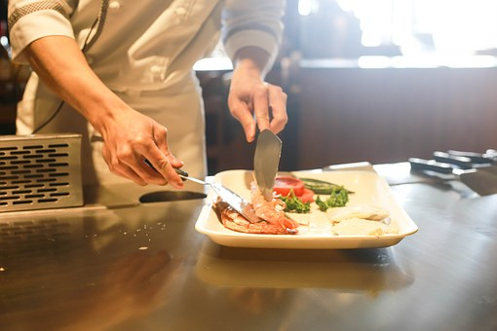
Cooking a Spanish dish
10 points

Slide 9

Name 2 famous German sports players
2 points

Slide 10
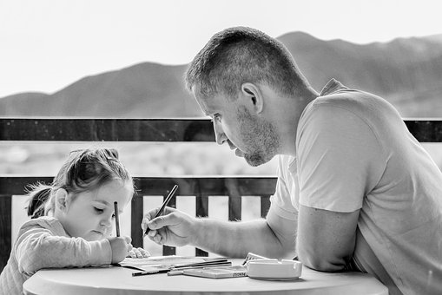
Teach your tutors a phrase in German
3 points

Slide 11
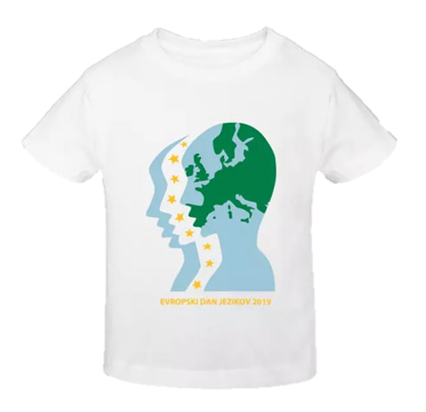
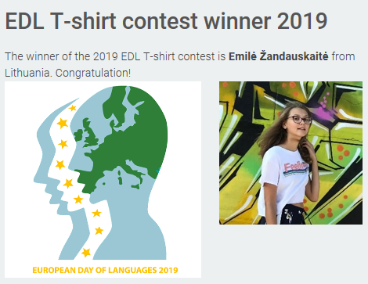
Part 2: T-shirt logo contest

Slide 12
Merci, Danke and Gracias

